Slide 1
LET`S BEGIN

Slide 2

QR DAW M

Slide 3
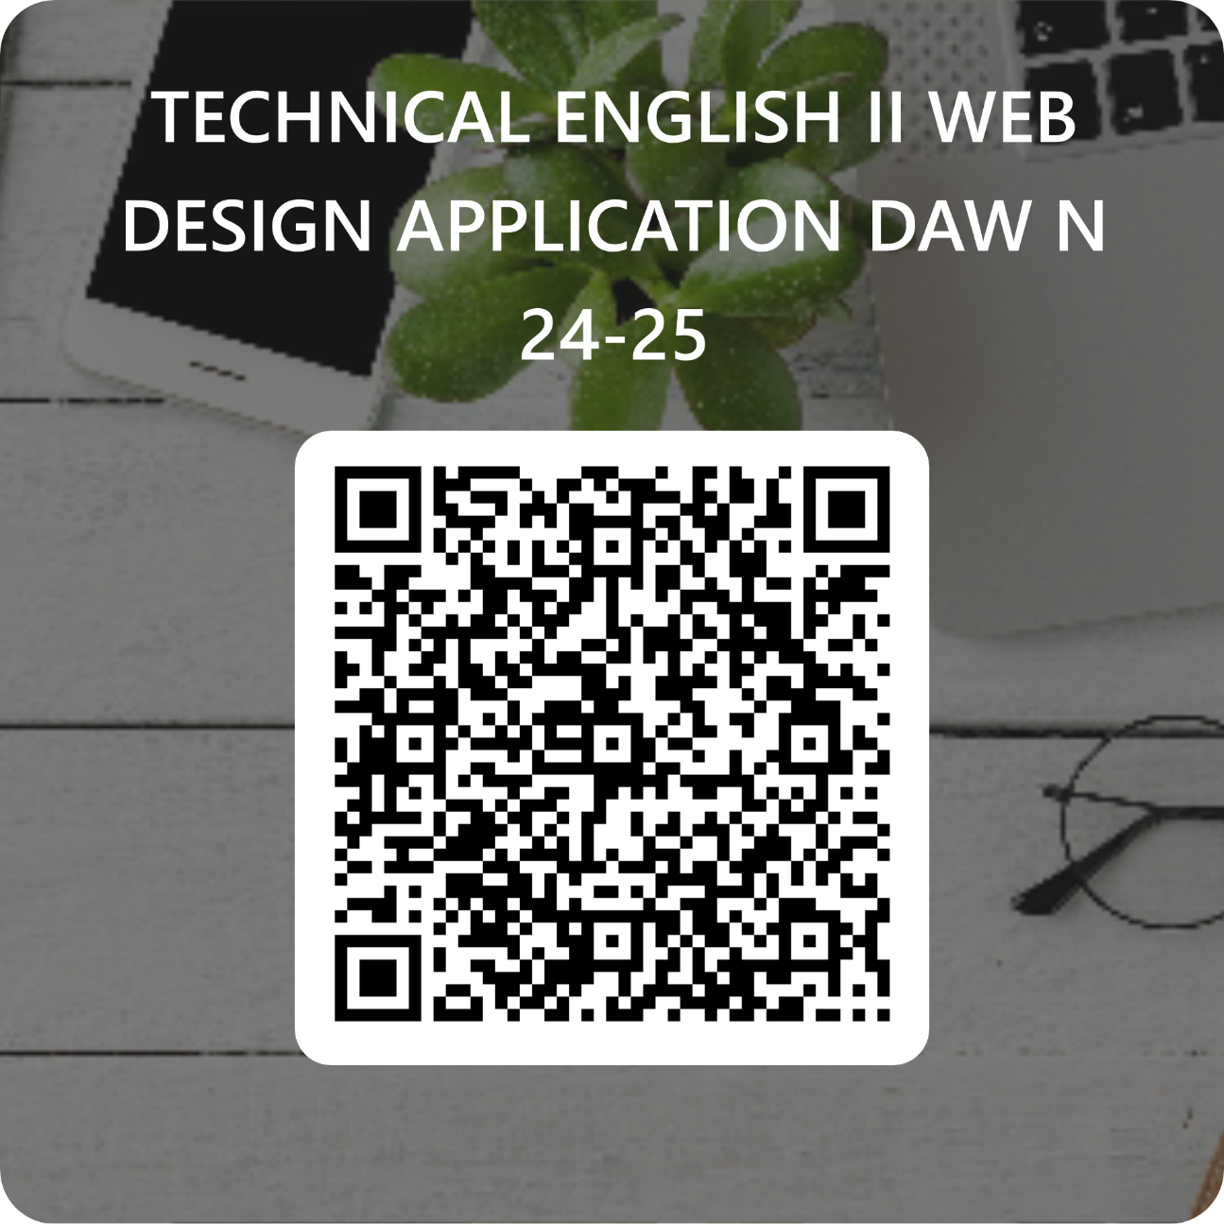
QR DAW N

Slide 4
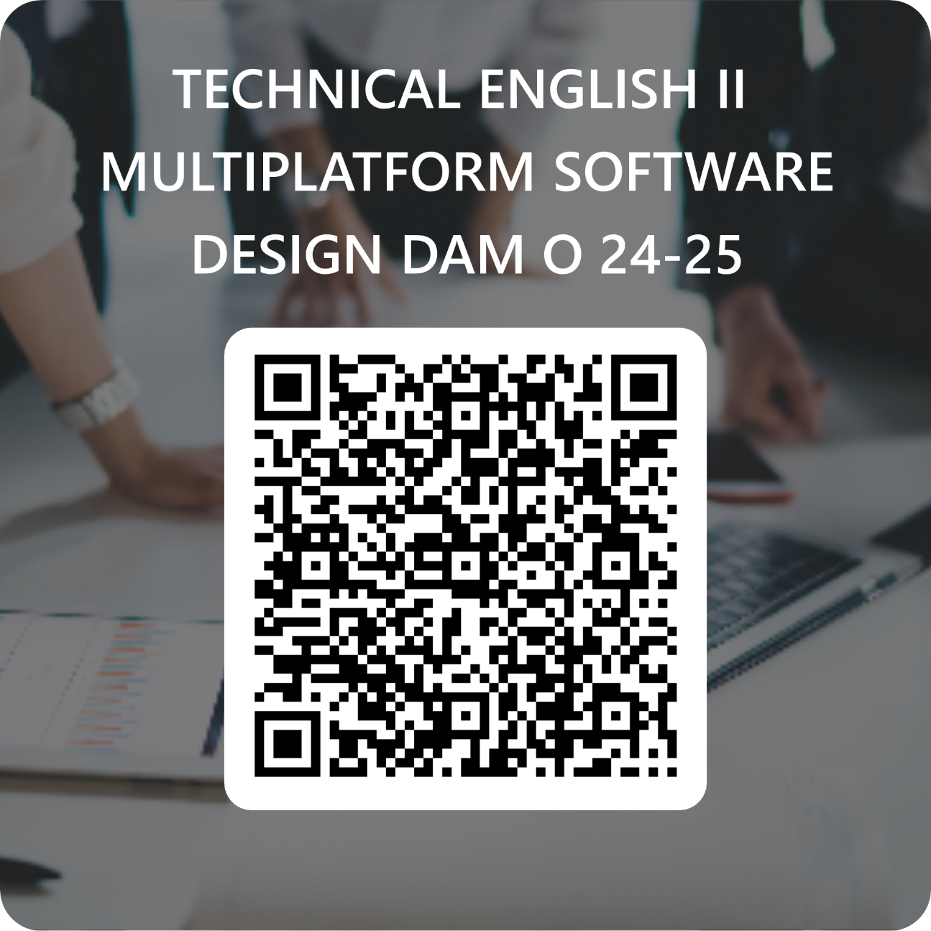
QR DAM O

Slide 5
SPEED TALKING
TALK FOR ONE MINUTE TO THE PERSON IN FRONT OF YOU: What is your name? Name three things you did in summer Tell me three adjectives that describe you

Slide 6
CLASS RULES
Talk to your teacher and classmates as you’d like them to talk to you: help each other
Don’t interrupt the teacher or other students, ask others what they think, raise your hand to speak
Be on time and have your material out and be ready to go in 30 seconds! Change tasks quickly to avoid wasting time
Tell someone if you’ve got a problem. If you see someone excluded, include them.
Try your hardest at all times, find ways to improve, learn from your mistakeds

Slide 7
COURSE CONTENTS AND GOALS
Effort and participation in class will be marked plus written homework assignments (20%)
Speaking presentations
Group projects
Plus Unit achievement tests (vocab, reading, listening…). (80%)
Pass mark, 5 on all skills, to add up score
Retakes will be provided on all exams

Slide 8


CANDY COLOUR TALK
RED: You are a giant. What’s on your to-do list today?
PURPLE/PINK: It is the year 2117. Describe what you see.
GREEN/BLUE: Describe your childhood in 7 words.
YELLOW: List five big things that have happened in your life.
ORANGE: Ways that you and your mother are alike.

Slide 9
DO YOU BELIEVE EVERYTHING IN THIS LETTER?
Dear students, I am going to introduce myself. My name is Pilar. I have spent summer in a mobile home in Campello and used an electric bike to move around. I am fond of swimming and allergic to peaches and hazelnuts My eyes are brown but usually wear blue contact lenses. I don't have any kids but have two dogs

Slide 10
THE FIRST COMPUTER
https://www.youtube.com/watch?v=k4oGI_dNaPc (the first computer University of Pennsylvania)
The first computer was built in 1946 / 1956
Engineers needed a machine that solved difficult equations / did calculations / clicked on and off/ all previous
ENIAC stands for:
Engineers were recruited for II world war TRUE / FALSE. Why?
ENIAC was the first computers / included the basic architecture of modern computers/ both
ENIAC is /isn’t in the origins of modern Google, Microsoft…

